Slide 1

UNIT 1: Who am I?
My favourite band

Slide 2
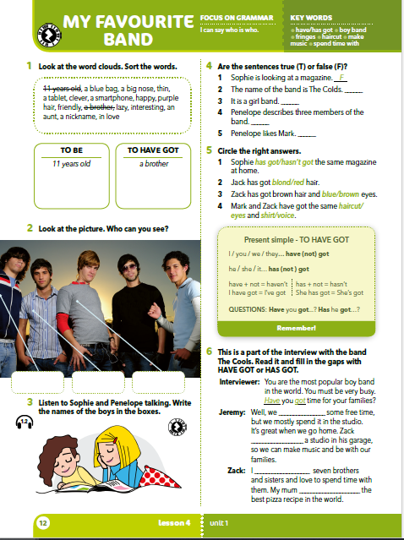
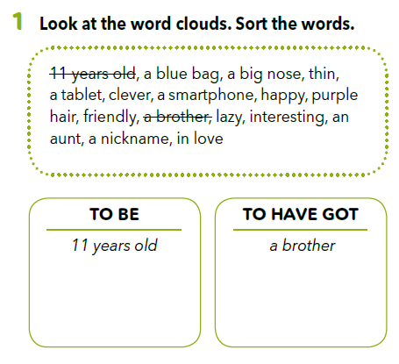
TO BE or TO HAVE GOT?
Sort the words into the correct category. After that say the sentences. Primjer: I am 11 years old.
I have got a brother.
Check again: https://learningapps.org/view5192259

Slide 3
LET’S PRACTISE!
TO BE or TO HAVE GOT?
Let’s practice!
https://learningapps.org/view5192285

Slide 4
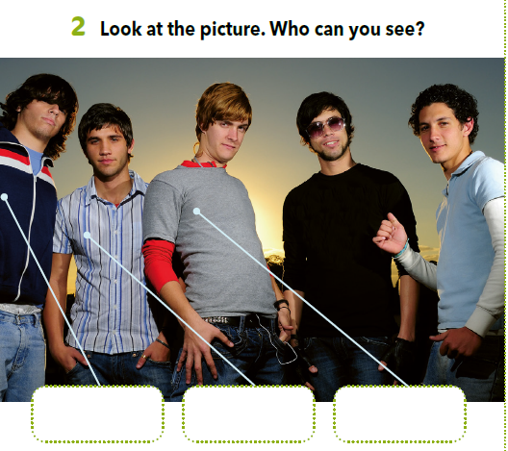
Look at the picture and describe it. Who can you see? Npr. There are five boys…

Slide 5
Translate:
cute –
dreamy –
haircut –
comb –
sladak
divan
frizura
češalj

Slide 6

Listen to Sophie and Penelope talking. Write the names of the boys (Zack, Jeremy, Jack) in the boxes.
https://www.e-sfera.hr/dodatni-digitalni-sadrzaji/82f9a72f-9ee6-42bc-b038-0b380502a8ee/
Jeremy
Zack
Jack

Slide 7
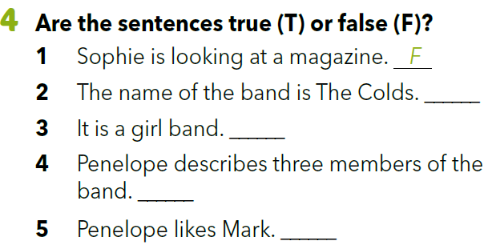
F
F
T
Listen and check your answers.
T

Slide 8
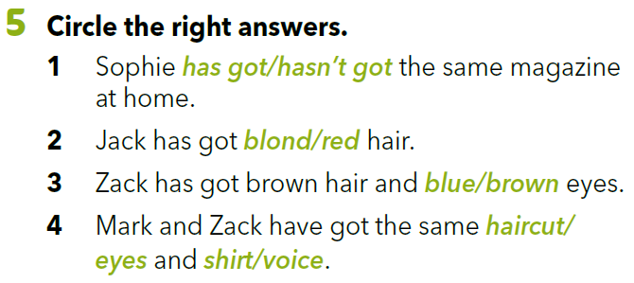
Listen and check your answers.

Slide 9
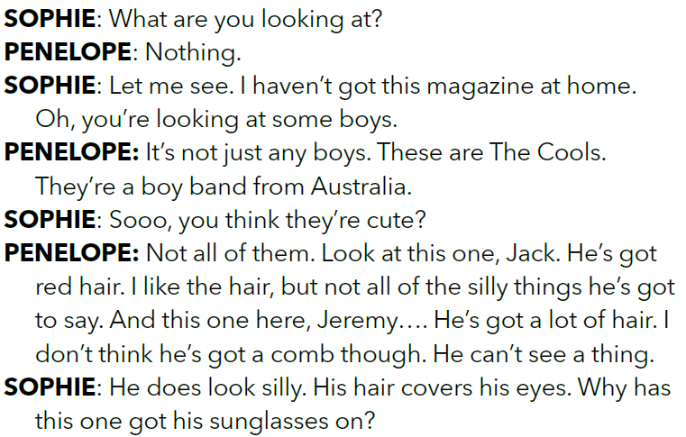
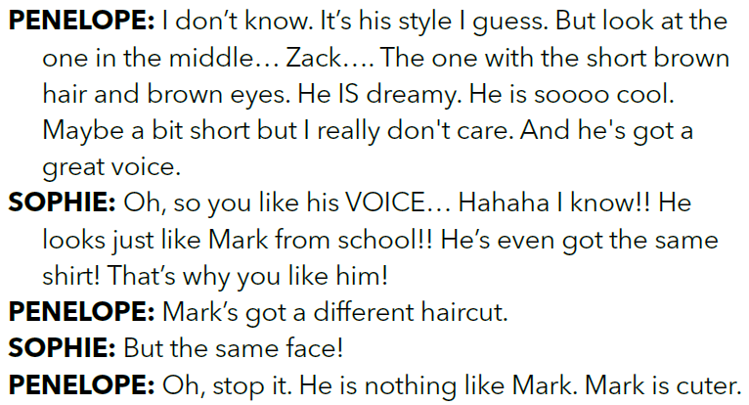
Look at the audio script. Can you find the examples of the verb ‘’to have got”?

Slide 10
HAVE GOT or HAS GOT?
I We
You You
He They
She
It
have got
have got
have got
have got
has got
have got
has got
has got
TO HAVE GOT = imati

Slide 11
Look at the examples:
I have got a bike. ili I’ve got a bike.
I have not got a car. ili I haven’t got a car.
Have you got a car?
She has got a bike. ili She’s got a bike.
She has not got a car. ili She hasn’t got a car.
Has she got a car?

Slide 12
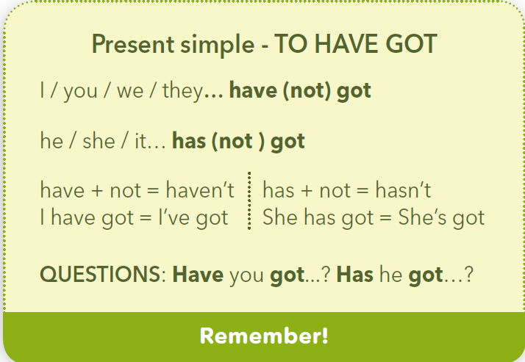

Slide 13
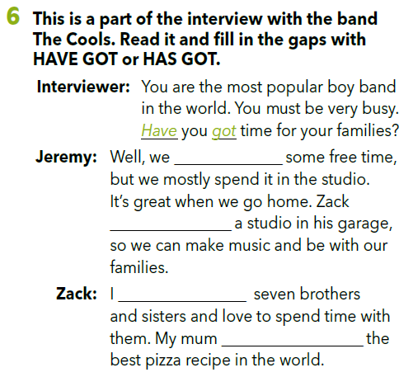
Read the interview and fill in the gaps with have got or has got.
have got
has got
have got
has got

Slide 14
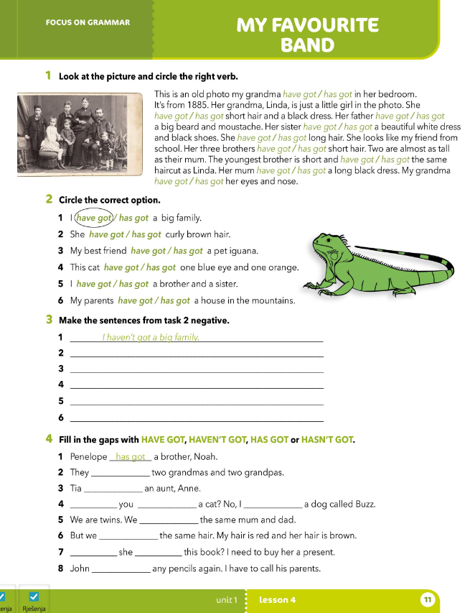
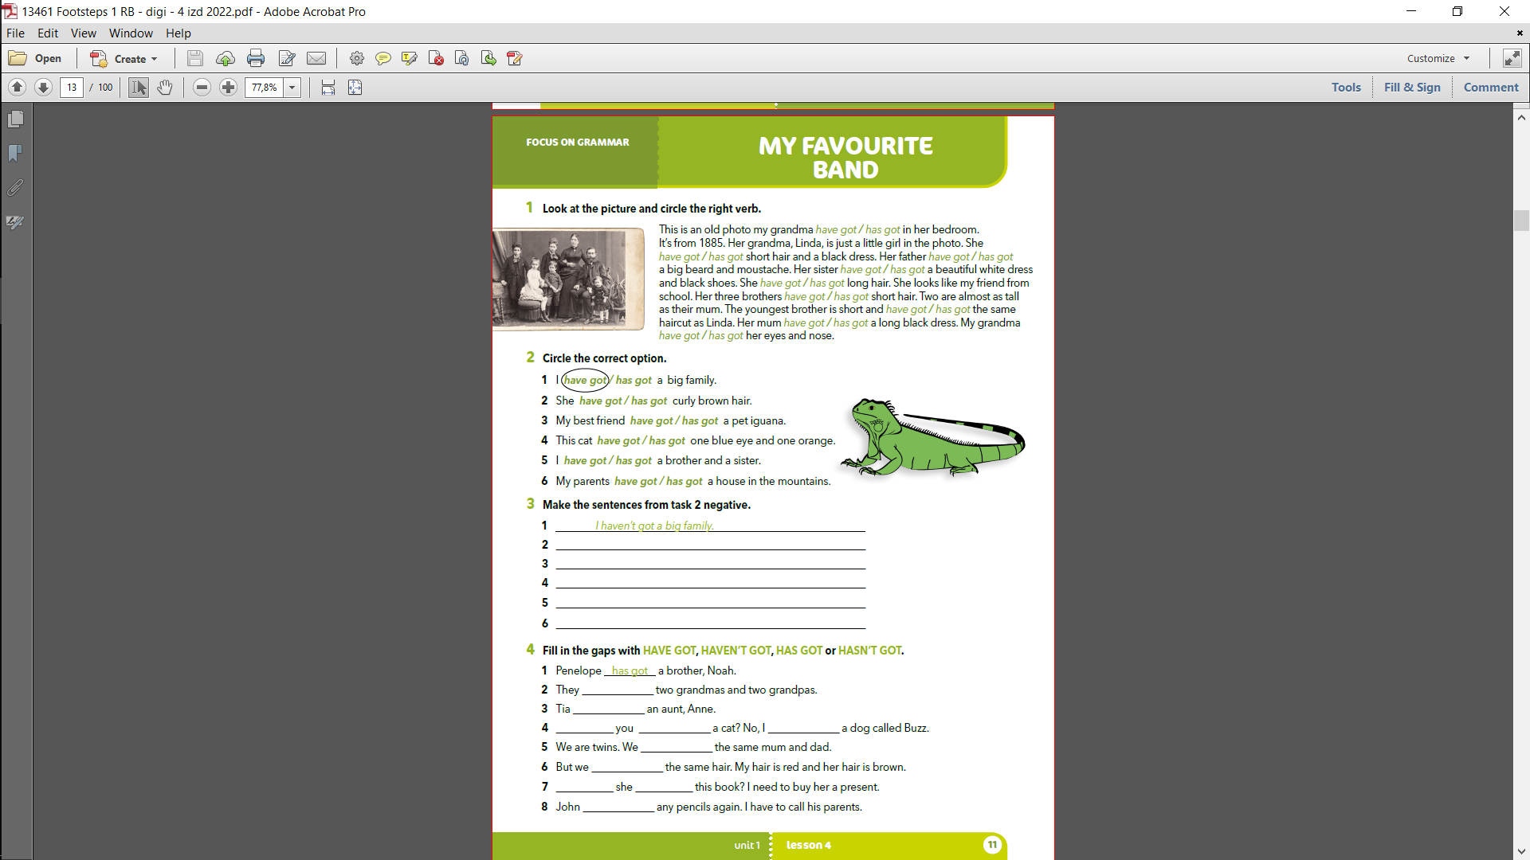

Slide 15
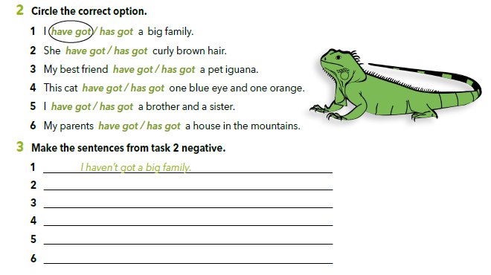
She hasn’t got curly brown hair.
My best friend. doesn’t have a pet iguana
This cat hasn’t got one blue eye and one orange.
I haven’t got a brother or a sister.
My parent’s haven’t got a house in the mountains.

Slide 16
have got
has got
Have got
have got
have got
haven’t got
Has got
has got

Slide 17
SELF-CHECK!
Check your knowledge!
https://www.e-sfera.hr/dodatni-digitalni-sadrzaji/82f9a72f-9ee6-42bc-b038-0b380502a8ee/

